Slide 1
turtle race
INT- 213
PYTHON PROGRAMMING
Submitted by:
BAMMIDI SAI CHANDRA SEKHAR(11802374)
PATHPATI SAI KUMAR(11804760)

Slide 2
DIVISION OF WORK:
Game and home screen (in partition)
Login and sign up page designing (sai kumar)
Database (sai Chandra sekhar)

Slide 3
ABOUT THE GAME:
In this game , the race is conducted between the four turtles.
Among those turtles we have to select one of the turtle.
After your selecti0n the game has been started.
The one turtle which reaches the end of the track first will be declared as winner.
If your selected turtle reaches the end then you will be the winner.

Slide 4
Modules used:
The modules used for this project are:
1) Home screen.
2) log in.
3) signup.
4)game.

Slide 5
ABOUT HOME SCREEN MODULE:
We import tkinter to complete this module.
By importing tkinter we can get the widgets like “entry”, “label”, “button”.
In this module we display the three buttons named “log in” , “sign up”, “play as guest”.
By clicking on the signup button then it is redirected to signup page.
By clicking on the login button then it is redirected to login page.
By clicking on the play as guest then it is directly redirected to game with out login page.

Slide 6
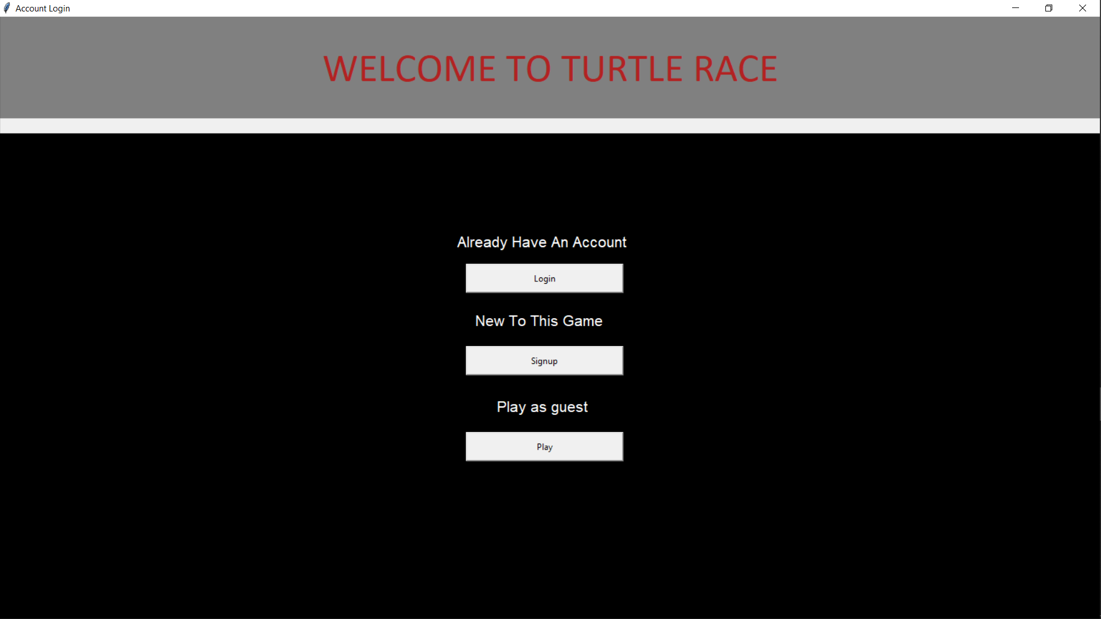
SNAPSHOT
OF
HOME SCREEN

Slide 7
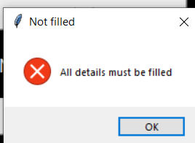
ABOUT SIGNUP PAGE:
As we import the tkinter library for home screen the same used for this module and we import sqlite3 module to store the information in database.
We use the entry widget to take the information from the user and store it in a database after completion of filling of all fields.
If we forget to fill any one of the field then it shows the validation.
By clicking on the submit button the information you entered is directly stored in data base and redirect you to login page.

Slide 8
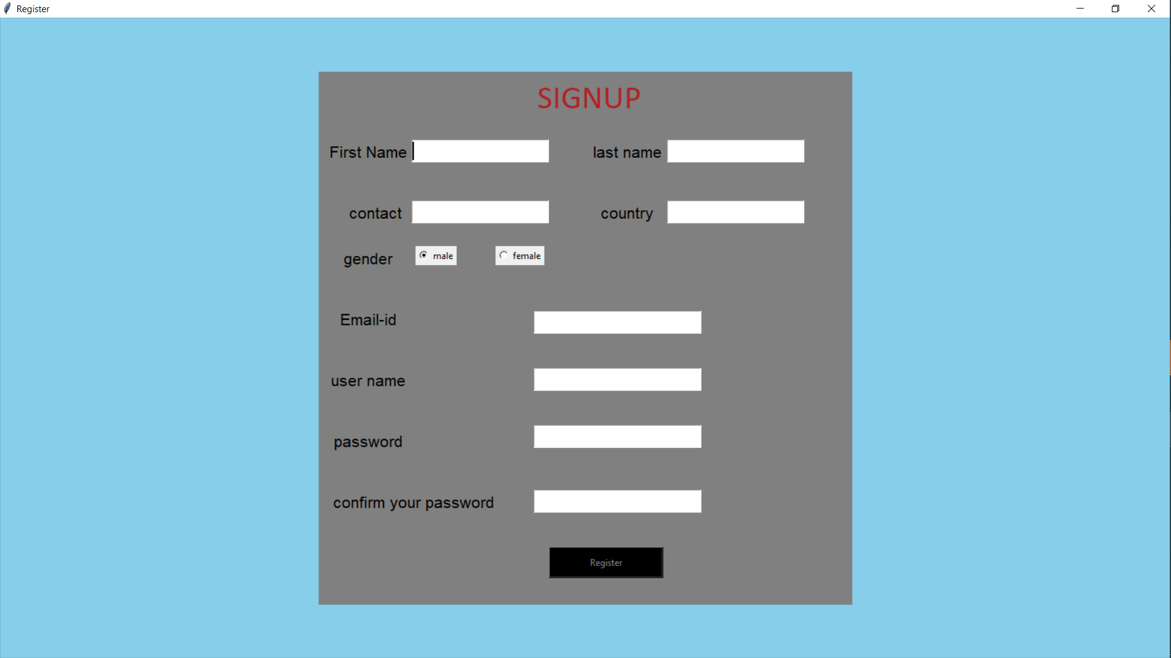
SNAPSHOT
OF
SIGNUP PAGE

Slide 9
ABOUT LOGIN PAGE:
Same as signup page we import tkinter and sqlite3 libraries to complete this page.
Here, we use entry widget to fill the user credentials.
And we have one button named login. By clicking on the login button we redirected to game if you fill all the credentials otherwise it will display the message box.

Slide 10
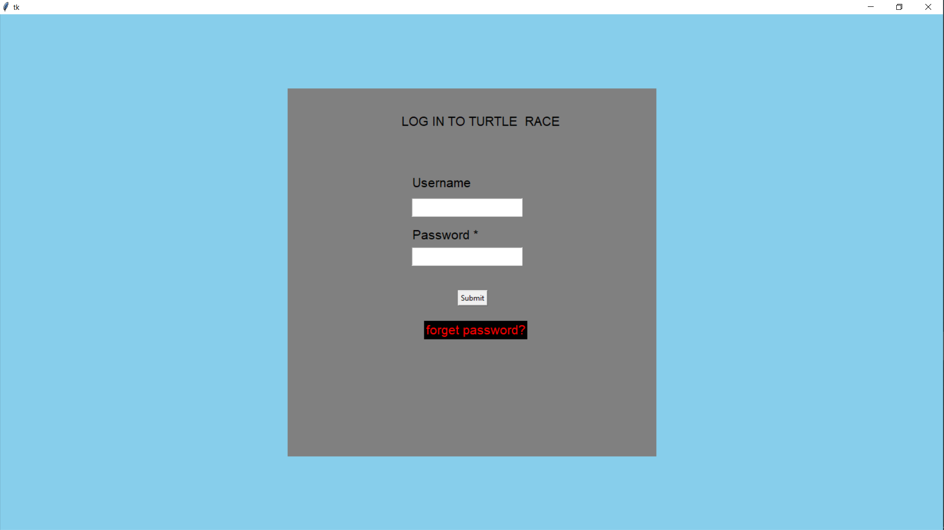
SNAPSHOT
OF
LOGIN PAGE

Slide 11
ABOUT THE GAME MODULE:
To reach this module we have two ways either by pressing the button “play as guest” on home screen or after login with the user credentials we directly enter into the game.
In this module we import modules like “turtle”, “randint”, pygame.
By importing turtle we can the get the features like forward, goto, penup, pendown etc..,
By using randint we make turtles to manage their speed.
By using the pygame we put the background music to our game.

Slide 12
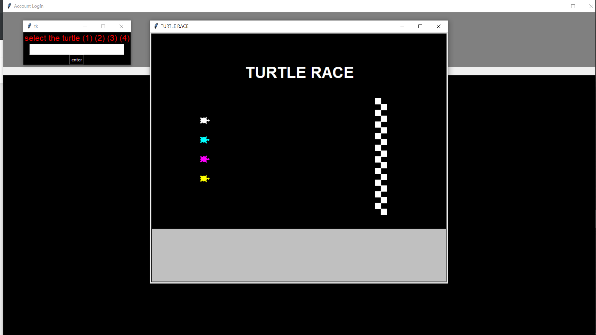
SNAPSHOT
OF
Game

Slide 13
References:
Geeks for geeks for the help of tkinter module.
For turtle we take the reference of some you tube channels.

Slide 14

THANK YOU

